Slide 1
Linguistic Technology Systems
NCN/A3R or “NA3”
Native Application
Development Framework
Screenshots and Case-Studies
accompanying the NA3 White Paper

Slide 2
Case study: E-Commerce
This slide and the next will explain screenshots appearing in slides 4-7
• Individual products are shown in a “dock aggregate” that can be part of a multi-window display (figure EC-1).
• The product view can be “split” into smaller windows that can be rearranged or even re-assembled in different combinations, giving users control over layout (EC-2).

Slide 3
E-Commerce Figures Overview (continued)
• Shoppers can explore color combinations by creating “color pairs” using an HSV wheel gadget; favorite pairs can be saved (EC-3).
• The “shopping cart” resides in a separate window that can be raised from product views via a context menu. Shoppers can quickly switch between product and cart views (EC-4).
• 3D product views can be exported to MeshLab (EC-5).

Slide 4
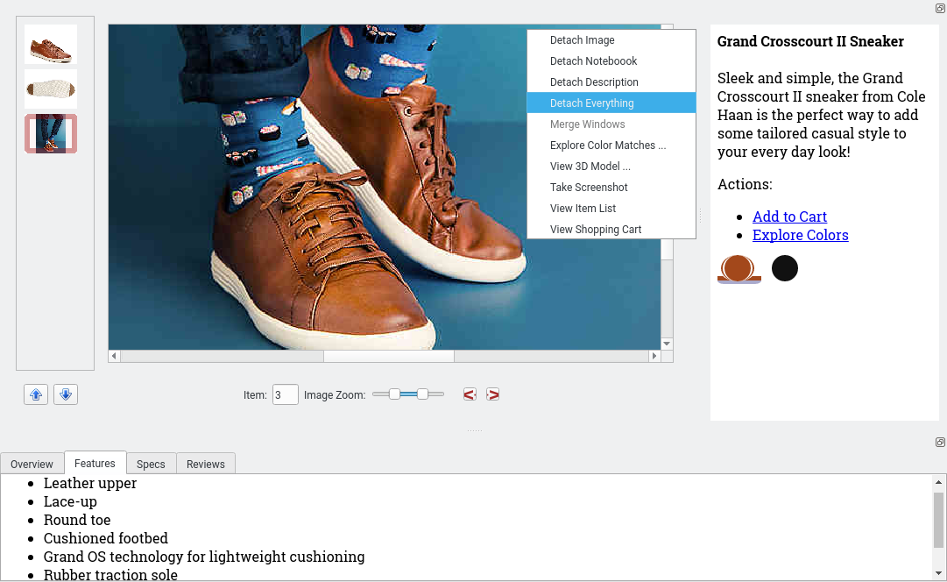
Figure EC-1
Context Menu shows option to detach panels (see next slide)
Dockable panels are initially affixed to bottom and right of main product image display.

Slide 5
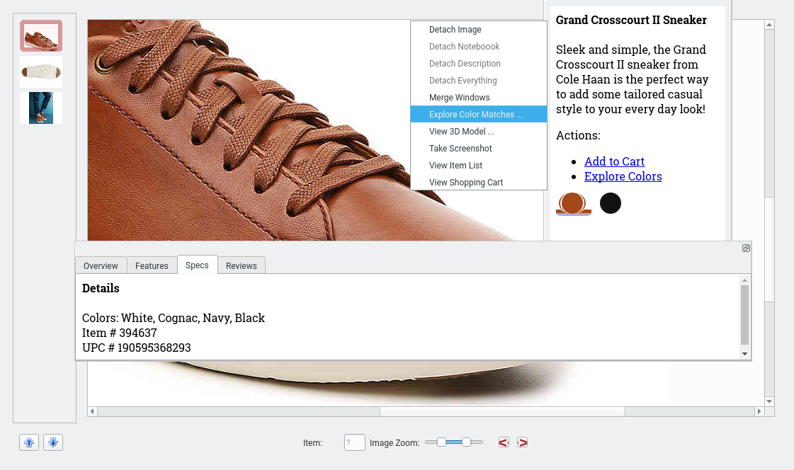
Figure EC-2
Context Menu shows option to explore matches based on current selected product color (see next slide)
Dockable panels have been separated into autonomous floating windows.

Slide 6
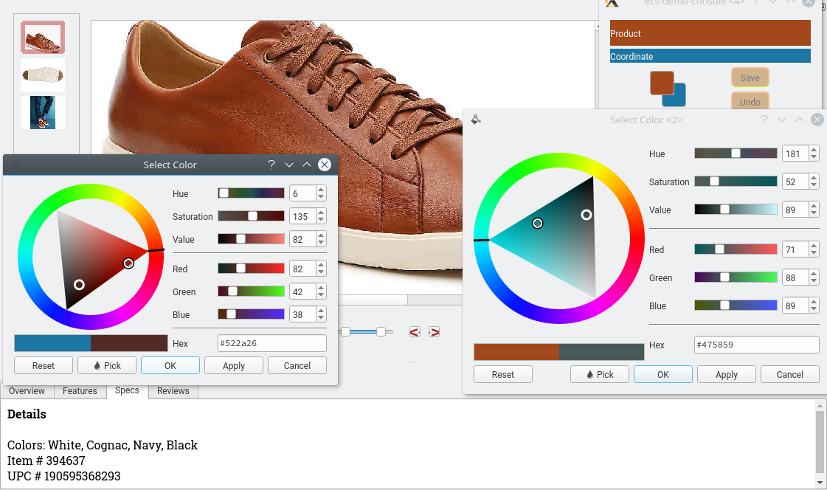
Figure EC-3
Initial complementary-color Product/Coordinate Pair
HSV Dialogs show users exploring color matches by testing pairs based on produce color and its optical complement

Slide 7
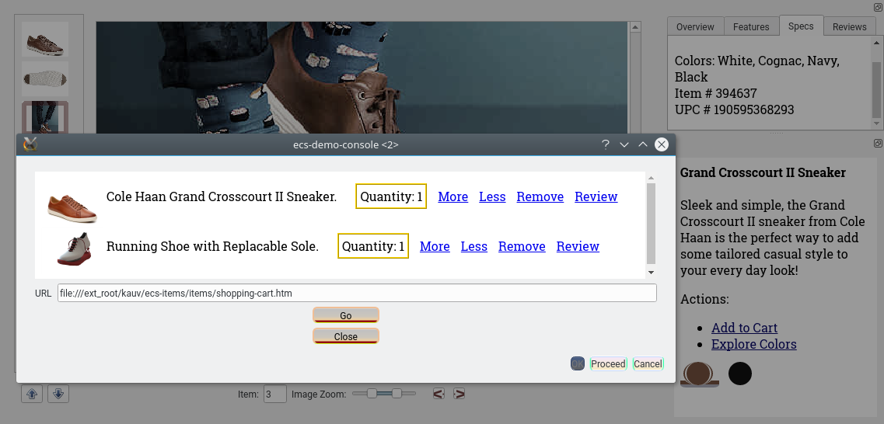
Figure EC-4
Background shows both panels docked on right
Shopping Cart shown in temporary window floating above a single-product view.

Slide 8
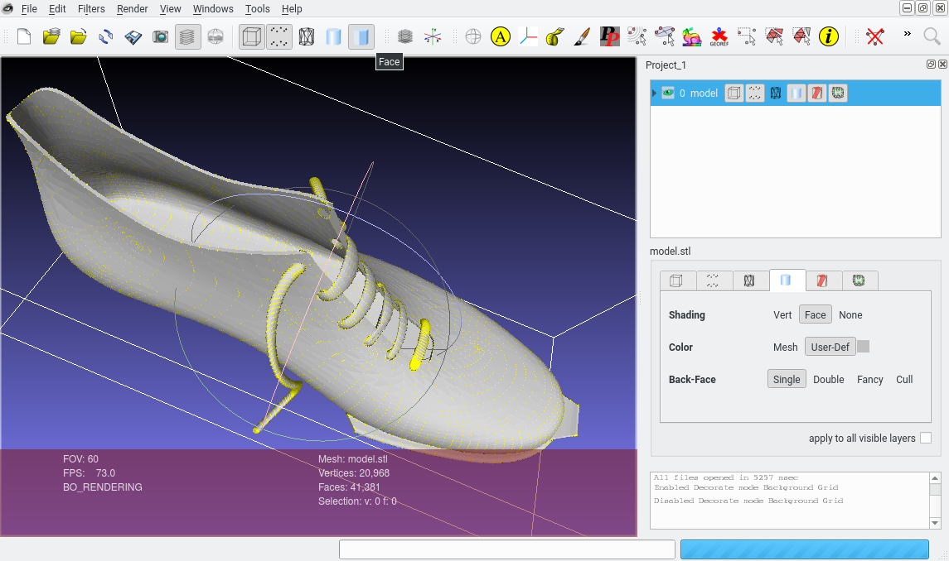
Figure EC-5
Shoe model exported to MeshLab

Slide 9
Case-Study: 3D Radiology
The screen-shots for this case-study show a workflow unifying two distinct Qt applications: 3DimViewer, a 3D Radiology program which constructs 3D tissue models from 2D image series; and MeshLab, a popular 3D graphics engine.
A3R components are compiled as extensions to both 3DimViewer and MeshLab so that these applications can interoperate. In particular, 3DimViewer can automatically launch and export data to MeshLab to examine autogenerated 3D tissue models.

Slide 10
3D Radiology Figures: Overview
• 3D radiology provides good workow examples because it combines several di erent technical areas, including image analysis, graphics, and Electronic Medical Records, requiring multi-tiered workflow management. ClouDynamo applications can share data so that the best viewers can be used for each file format (figure RAD-1).
• 3DimViewer includes a sophisticated analytic engine that builds 3D models from 2D image series, extrapolating 2D features to infer 3D volumetric geometry (RAD-2).

Slide 11
3D Radiology Figures Overview
(continued)
• 3D models are then passed to MeshLab, which supports a full suite of 3D processing and visualization (RAD-3).
• Similar data sharing allows 3D models to be embedded in PDF files and then accessed via ScignSeer, giving readers a full 3D experience – rather than the limited 3D format used by conventional PDF applications (RAD-4)

Slide 12
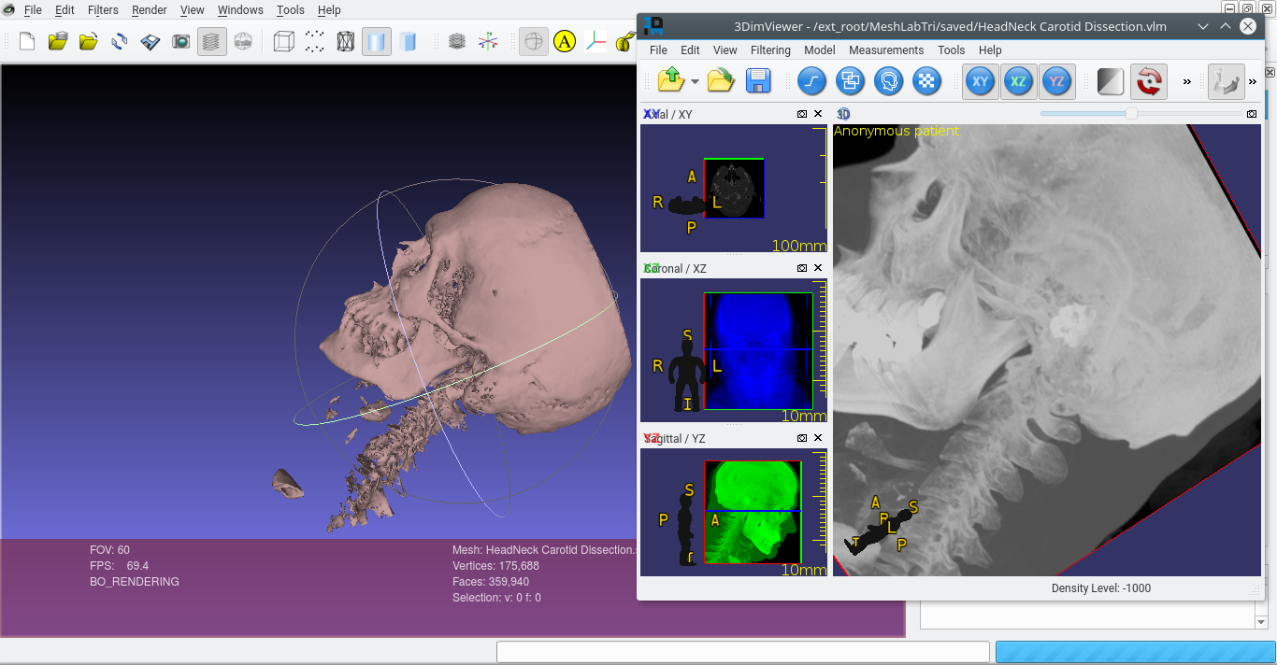
Figure RAD-1
3D Model automatically shared between the two applications
MeshLab
3DimViewer

Slide 13
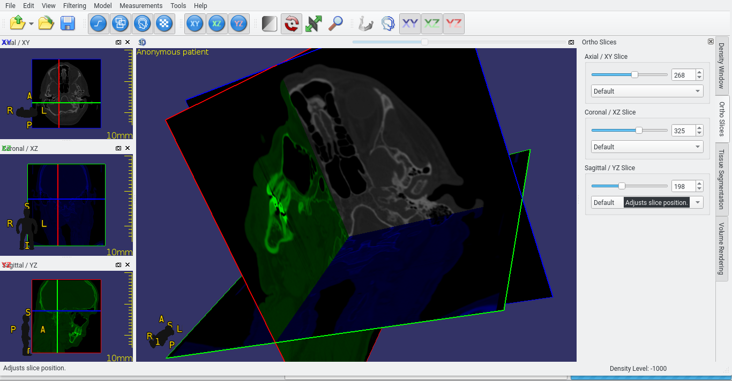
Figure RAD-2
3DimViewer’s strength is visualizing how 2D images fit into a 3D model

Slide 14
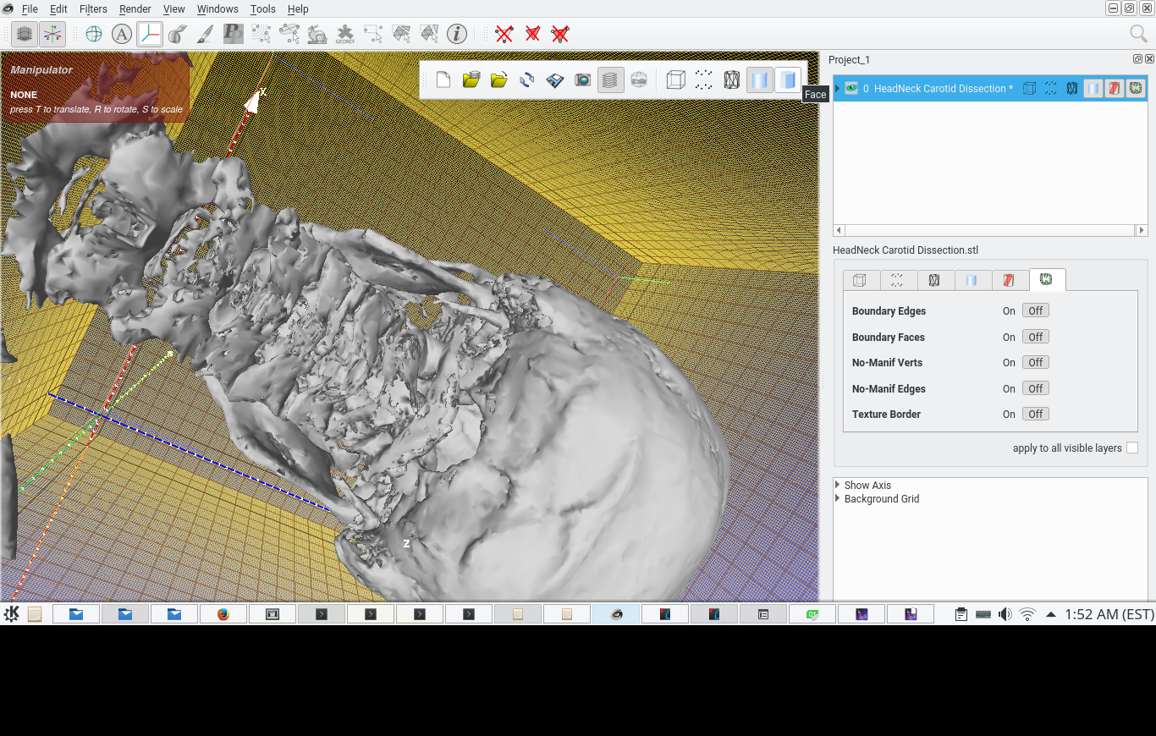
Figure RAD-3
MeshLab’s strength is how it lets users switch between many 3D view modes.
Since they have different strengths, 3D Radiologists like to use 3DimViwer and MeshLab in consort – a workflow that has been discussed in academic literature, but one which is streamlined and automated via ClouDynamo.

Slide 15
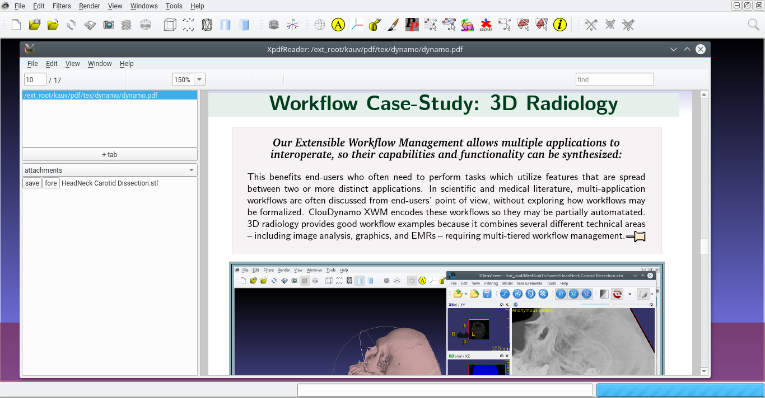
Figure RAD-4
File attachment list
Marker indicating a file embedded in this PDF page

Slide 16
Case-Study: Interactive Publishing
The screen-shots for this case-study show NA3 used with XPDF, a library and application for managing PDF files, and other document and bibliographic tools. (The slides are self-explanatory, so there is no “Figure Overview”)
Interactive reading experience is driven by A3R plugins which ensure that data and data sets embedded in publications can be properly accessed; that embedded multimedia and 3D graphics can be viewed or exported; and that dynamic web or Qt programming can be leveraged to create interactive presentations complementing publications.

Slide 17
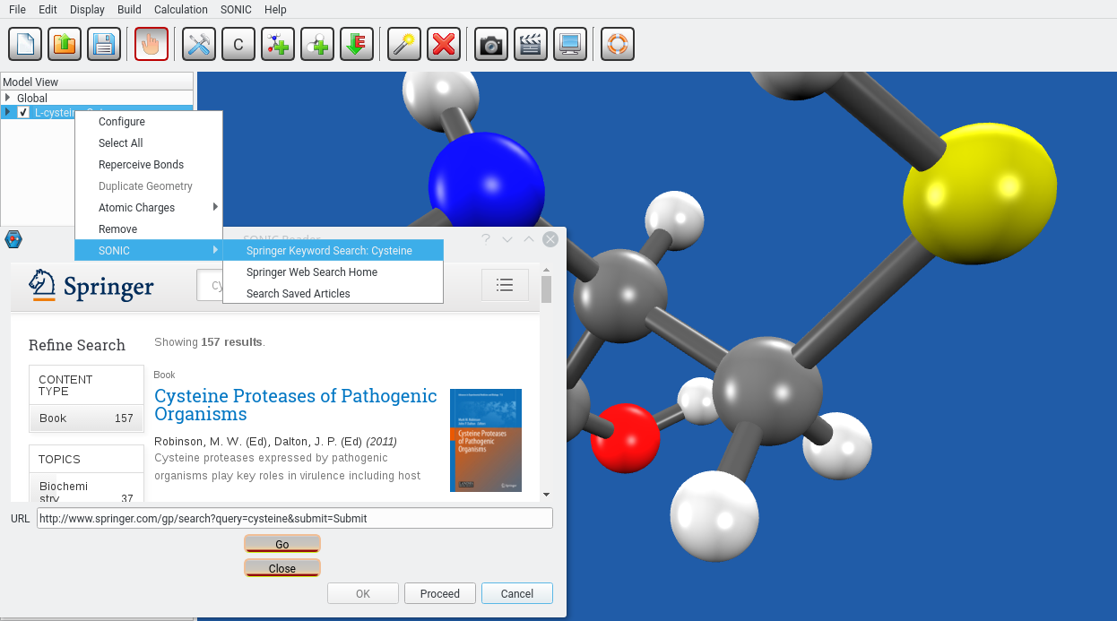
Figure PUB-1
This context menu derives from an HTXN plugin embedded in IQmol, a chemistry application.

Slide 18
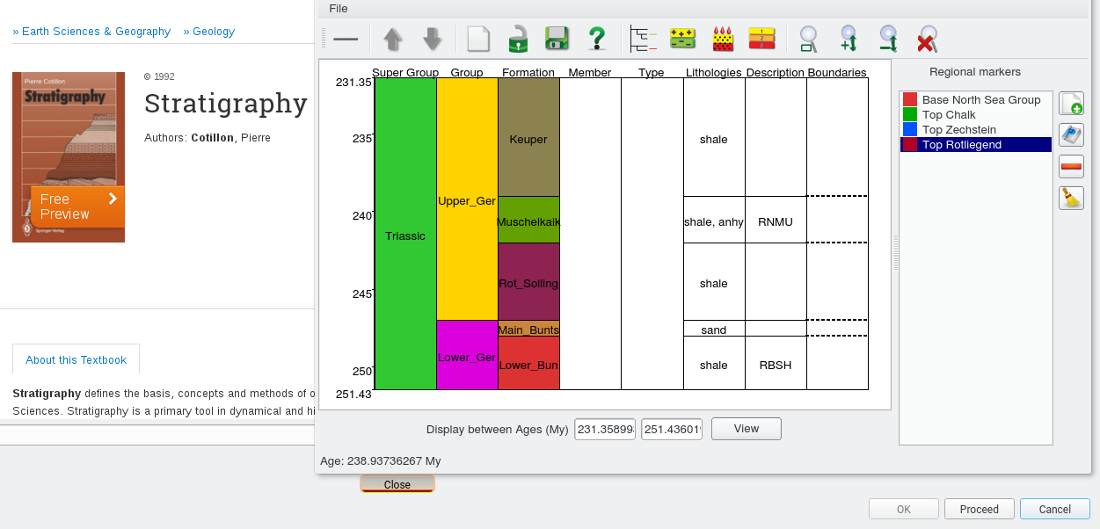
Figure PUB-2
Geoscientific application provides a viewer for specialized Stratigraphic file format.

Slide 19
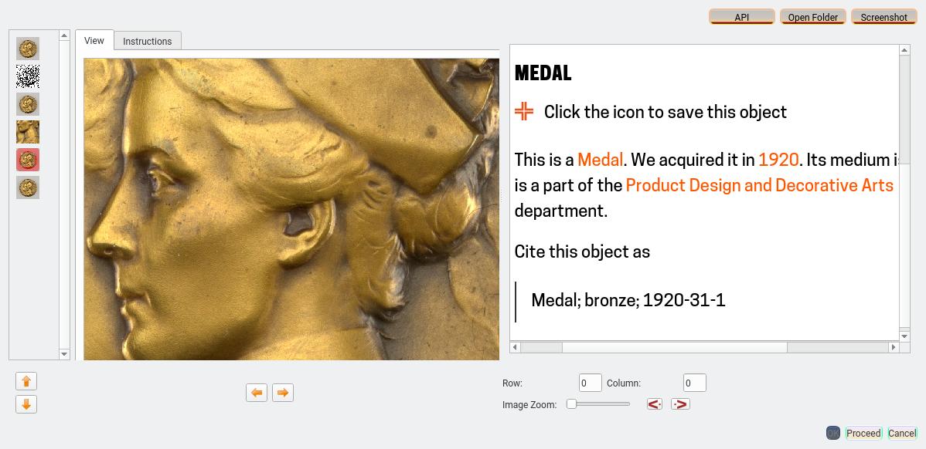
Figure PUB-3
Custom-designed front-end for a museum API, which can be embedded in publications that cite artifacts held by this museum (photo: Brooklyn Museum, NYC).

Slide 20
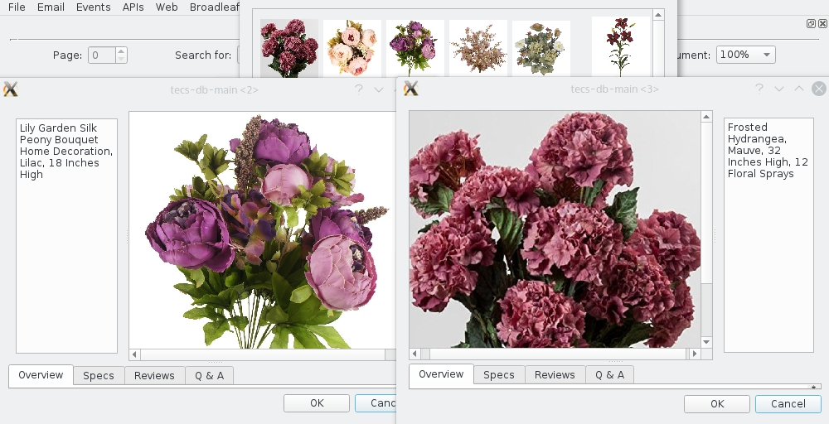
Figure PUB-4
PDF catalogs are an appealing, interactive enhancement to eCommerce sites.

Slide 21
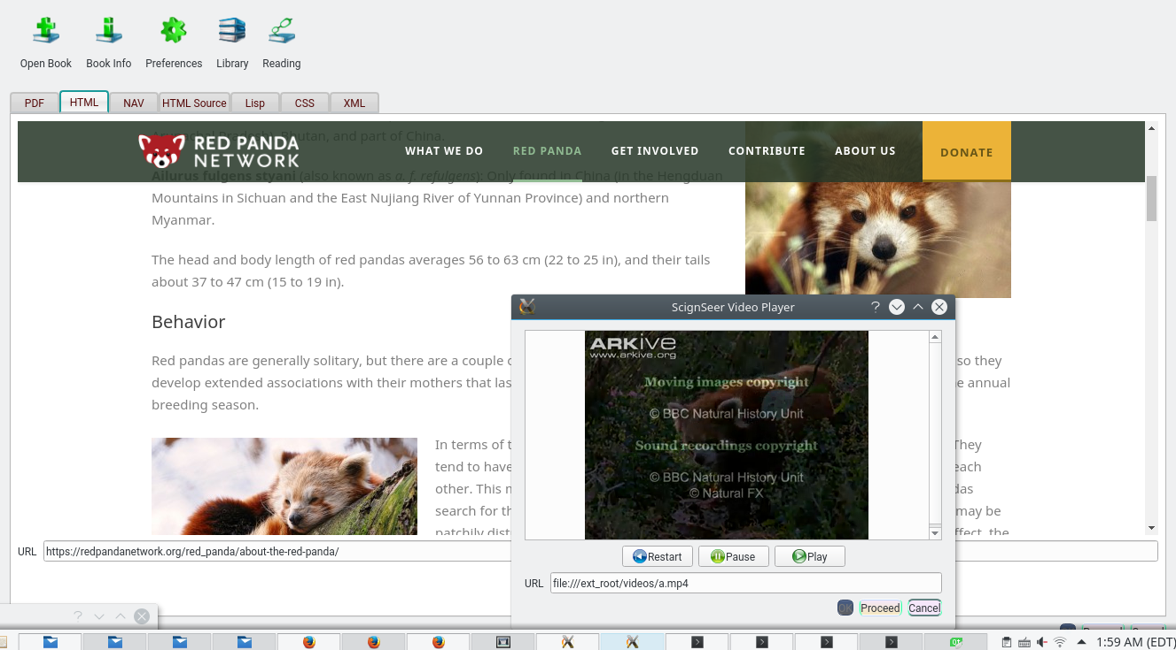
Figure PUB-5
E-Reader showing an embedded video-player window.

Slide 22
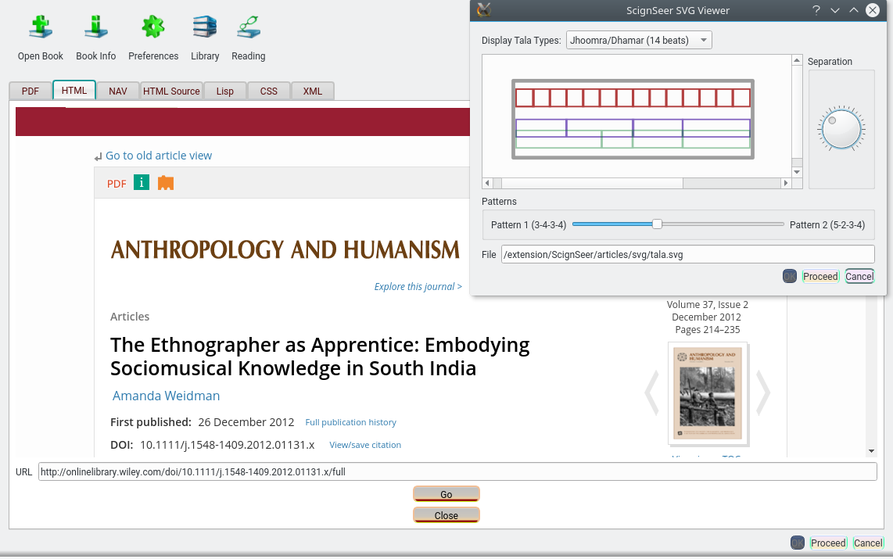
Figure PUB-6
Custom Qt window for exploring traditional South Indian rhythms, accompanying an ethnographic article on this subject.

Slide 23
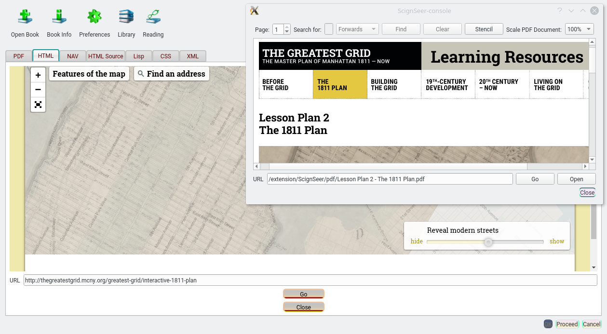
Figure PUB-7
Embedded web viewer allows interactive web presentations to be paired with PDF files.

Slide 24
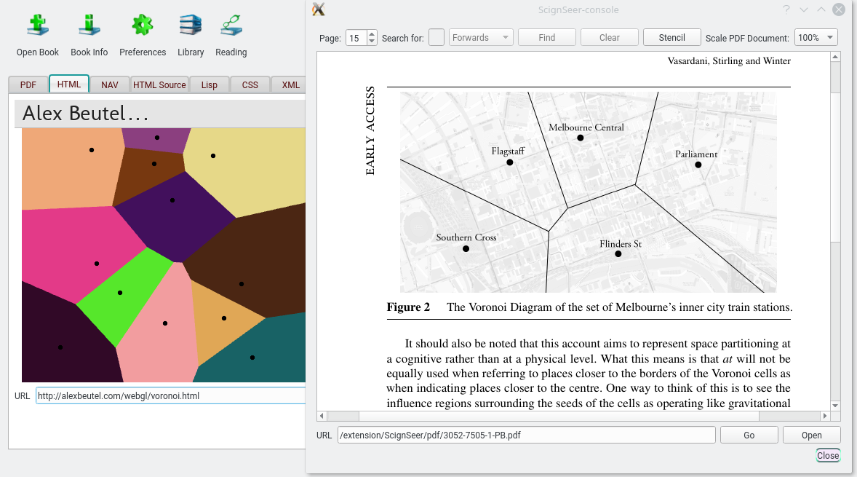
Figure PUB-8
Embedded web presentation can help readers explore and understand technical concepts when they occur in unexpected contexts (in this case, a mathematical term – Voronoi Diagrams -- in the context of linguistics and spatial reasoning).

